Slide 1
FIT3143
LECTURE WEEK 1
INTRODUCTION TO PARALLEL COMPUTING

Slide 2
Overview
Parallel computing concept and applications
Parallel computing models
Distributed computing
Parallel computing performance
Parallel vs. distributed vs. asynchronous computing
Associated learning outcomes
Explain the fundamental principles of parallel computing architectures and algorithms (LO1)
Analyze and evaluate the performance of parallel algorithms (LO4)

Slide 3
1. Parallel computing concept and applications
3

Slide 4
Definitions
A parallel computer is simply a single computer with multiple internal processors, or a group of multiple computers interconnected to form a coherent high-performance computing platform.
Parallel programming is programming multiple computers, or computers with multiple internal processors, to solve a problem at a greater computational speed than is possible with a single computer.

Slide 5
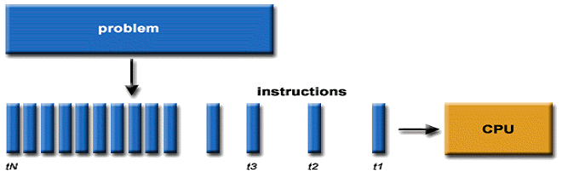
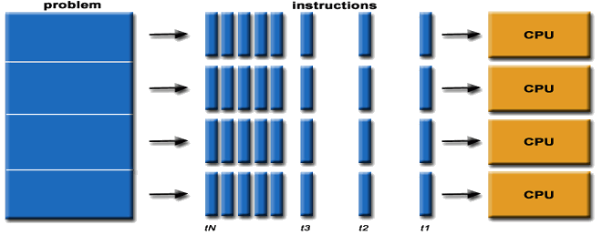
Serial Computing
Parallel Computing
Adapted from https://computing.llnl.gov/tutorials/parallel_comp/

Slide 6
The demand for computational speed
There is a continual demand for greater computational speed from a computer system than is currently possible.
Areas requiring great computational speed include numerical modeling and simulation of scientific and engineering problems.
Computations must be completed within a “reasonable” time period.

Slide 7
Grand challenge problems
A grand challenge problem is one that cannot be solved in a reasonable amount of time with today’s computers.
For example, an execution time of 10 years is usually
unacceptable.
Examples:
Modeling large DNA structures
Global weather forecasting
Modeling motion of astronomical bodies

Slide 8


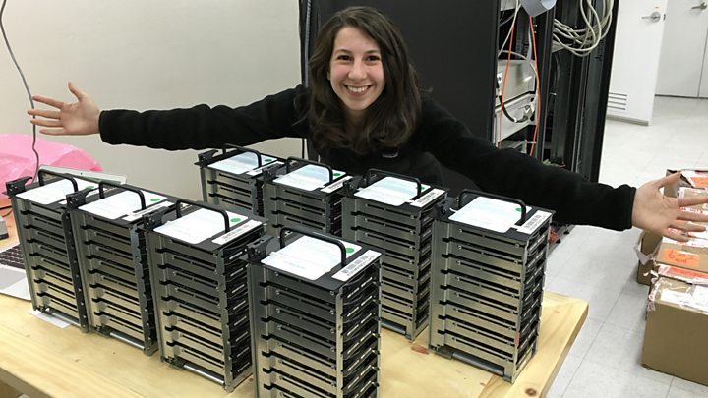
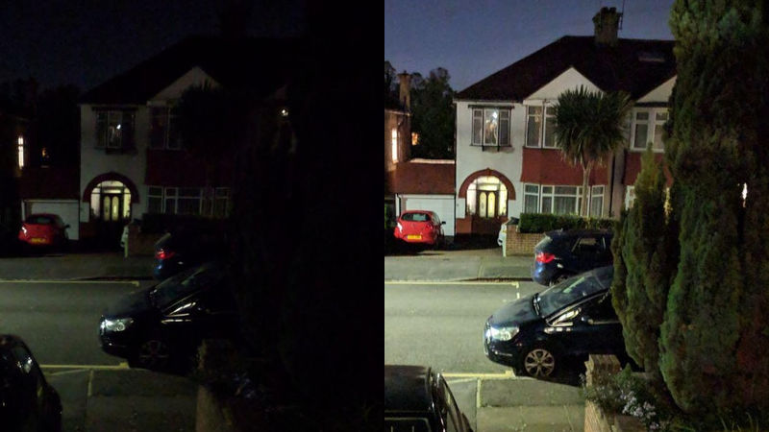
Computationally challenging problems

Slide 9
Reasons for not using existing serial machines
May not be able to reach the solution within a reasonable amount of time if using a single Von Neumann machine.
The limits imposed by both:
Physical constraints such as the speed of light
Cost of designing and manufacturing new chips.
Current speed of chips - may reach a few billion Hz but will not grow enormously beyond that.

Slide 10
Reasons for using parallel machines
With parallelism, much greater speeds can be achieved. The fastest computer in the world has a peak speed of about 415,530 Teraflops (https://top500.org/lists/top500/2020/06/). (flops: floating point instructions)
The enormous size of the problems that are being investigated. These problems fall in many domains of science, engineering, and economics.
To solve these problems requires carrying out huge numbers of computations, such as 10¹², 10¹⁴, 10¹⁶ or even more. This number of computations cannot be done by any existing serial machine but is feasible to attack using parallel processing.

Slide 11
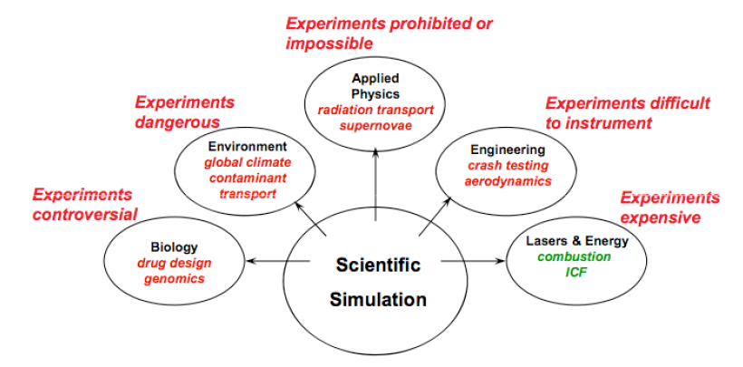
Why is Parallel Computing Important?
Source: Vivek Sarkar, Rice University, 2008

Slide 12
Some Particularly Challenging Computations
Science
Global climate modelling
Biology: genomics; protein folding; drug design
Astrophysical modelling
Computational Chemistry
Computational Material Sciences and Nanosciences
Engineering
Semiconductor design
Earthquake and structural modelling, remote sensing
Computation fluid dynamics (airplane design) & Combustion (engine design)
Simulation
Deep learning
Game design
Telecommunications (e.g. Network monitoring & optimization)
Autonomous systems
Business
Financial derivatives and economic modelling
Transaction processing, web services and search engines
Analytics
Defense
Nuclear weapons -- test by simulations
Cryptography
Source: Vivek Sarkar, Rice University, 2008

Slide 13
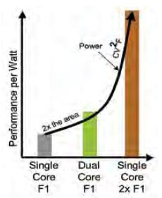
Why Parallelism is now necessary for Mainstream Computing?
In single core processor, the performance of the processor will not gain much simply by the increasing operating frequency:
Memory wall
The processor was incapable of optimizing the performance by increasing the operating frequency as the actual cause is the increasing gap between the CPU and memory throughput (data transfer rate).
ILP (Instruction Level Parallelism) wall
Difficulty in full parallel instruction processing.
Power wall
Power consumption doubled following the
doubling of operating frequency.
Faster clock speeds require higher input voltages.
Every transistor leaks a small amount of current
1% clock increase results in a 3% power increase.

Slide 14
Types of parallelism
Bit level parallelism
Parallelism achieved by doubling word size
Instruction level parallelism
Superscalar processor with multiple executing units and out of order execution.
Data level parallelism
Each processor performs the same task on different pieces of distributed data
Task level parallelism
Each processor executes a different thread (or process) on the same or different data

Slide 15
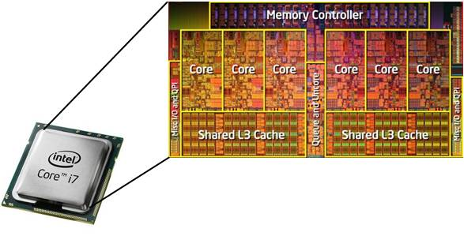
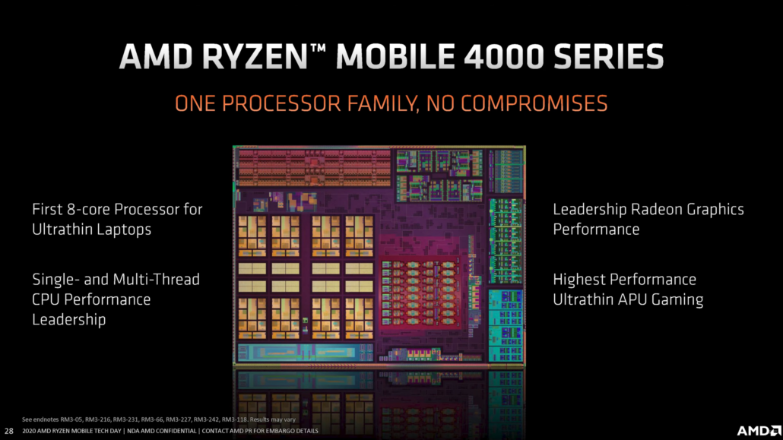
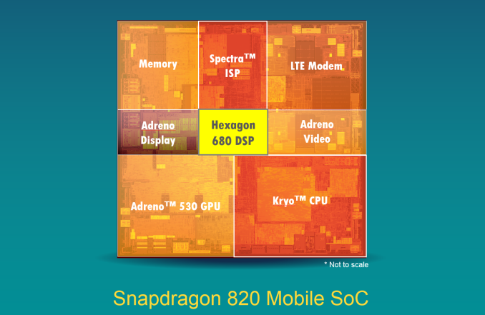
Classes of parallel computers
Multi core processor

Slide 16
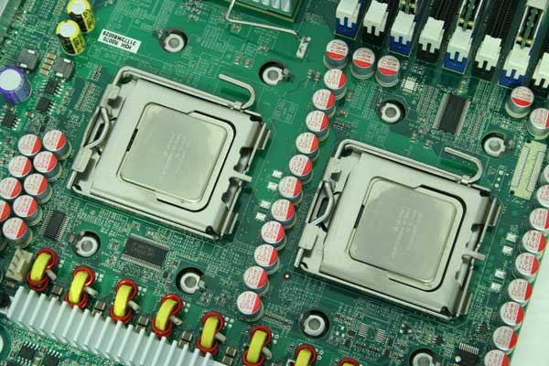
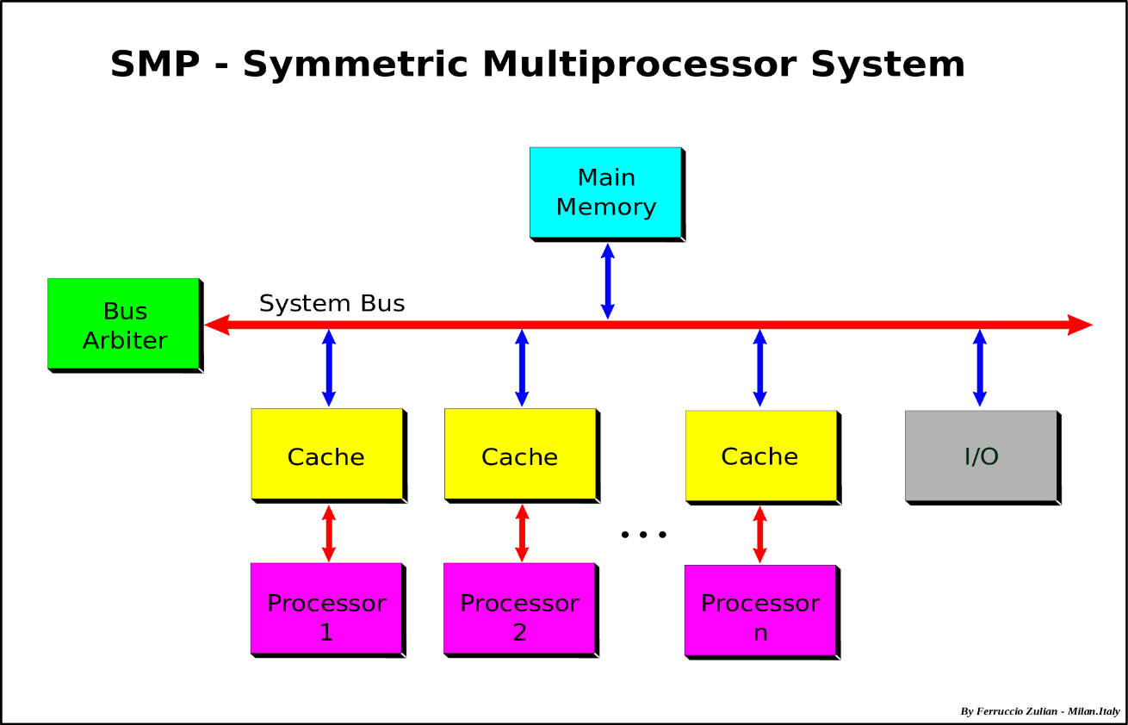
Classes of parallel computers
Symmetric multiprocessor

Slide 17

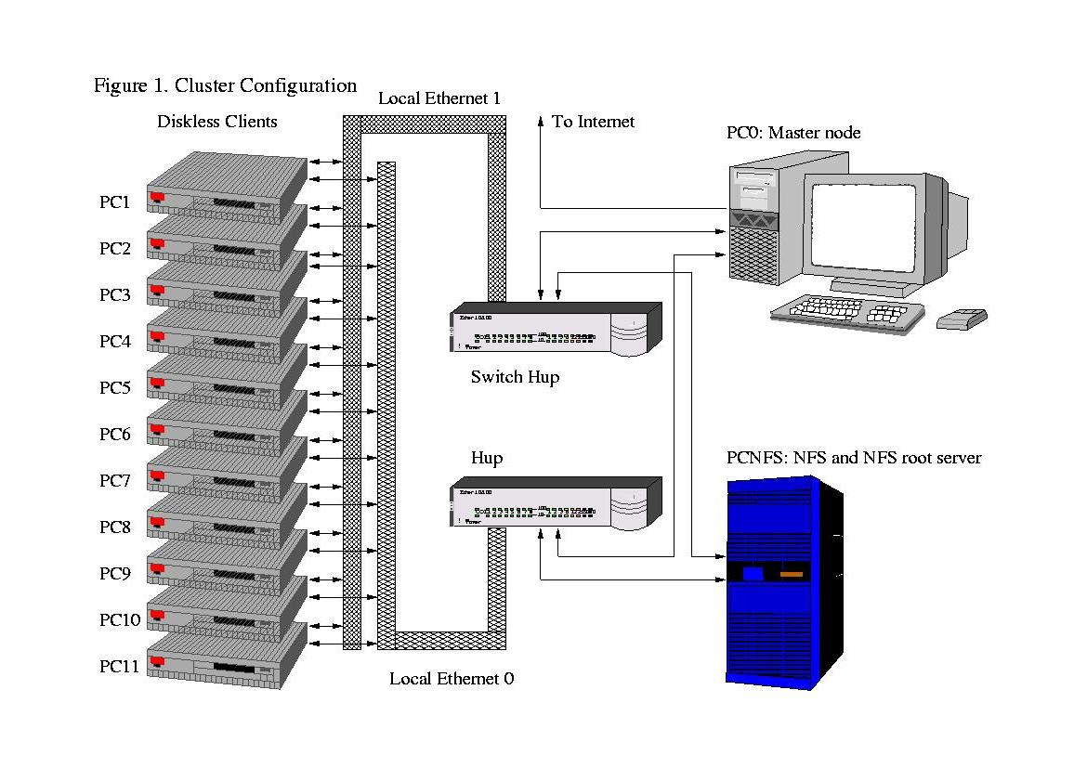
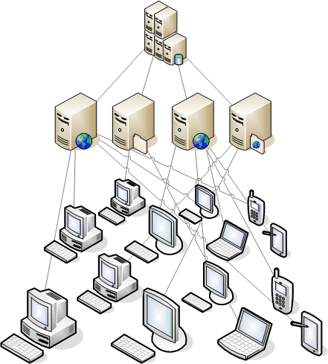
Classes of parallel computers
Cluster & Distributed/Grid computing

Slide 18

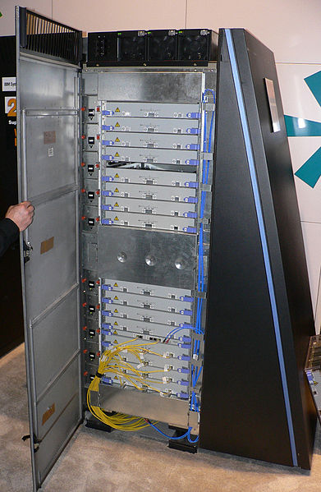
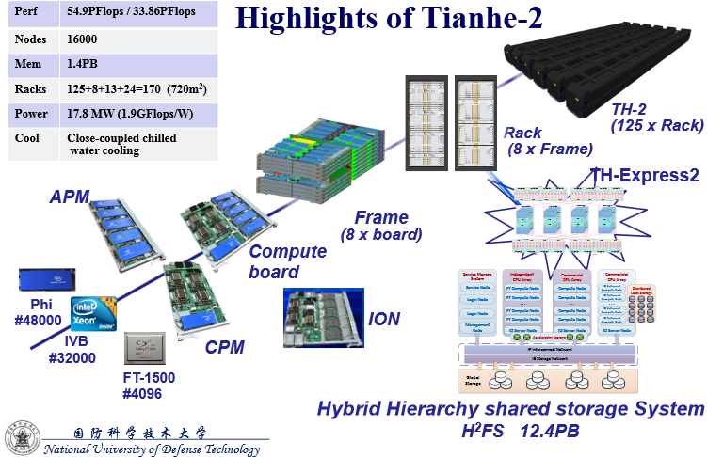
Classes of parallel computers
Massively parallel computing / supercomputing

Slide 19
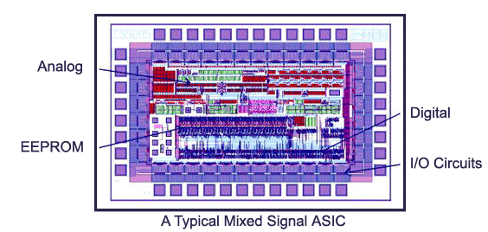
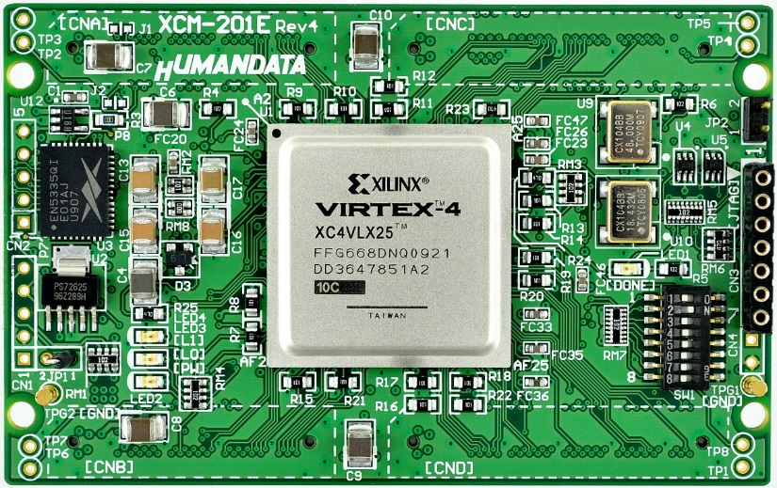
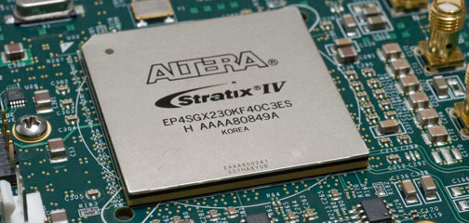
Classes of parallel computers
Reconfigurable computing (FPGA) & ASIC

Slide 20
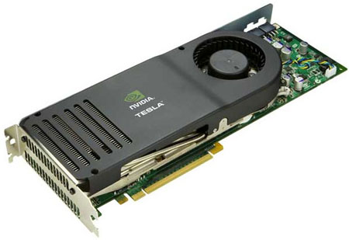
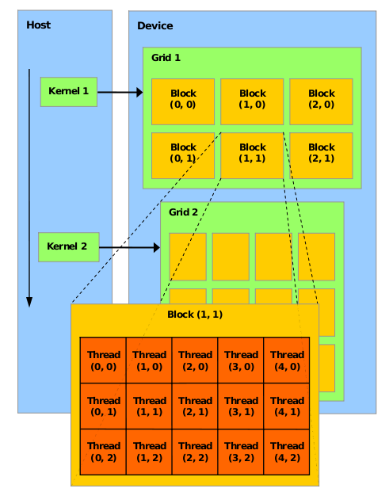
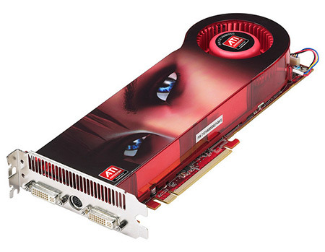
Classes of parallel computers
General-purpose computing on graphics processing units (GPGPU)

Slide 21
E.g. Embarrassingly parallel computation
An ideal parallel computation is one that can be immediately divided into completely independent parts that can be executed simultaneously – this is what is known as an embarrassingly-parallel computation, or job-level parallelism.
In this context, a network is a collection of integrated processors that are communicating and sharing information to speed up the solution to a single task.

Slide 22
Issues
1. How big of a collection?
- A few very powerful, special purpose computers? (2-64)
- Many smaller, standard microprocessors? (100-10,000)
- A huge number of simple, one bit processors? (billions, trillions)
2. What kind of processors?
- Special purpose?
- Standard microprocessors or Simple?
- One-bit processors?
3. How closely integrated is the collection of processors?
http://www.lsbu.ac.uk/oracle/oracle7/server/doc/SPS73/chap3.htm
- Tightly coupled? Designed as a single architecture and a single system.
- Loosely coupled? Systems that can operate as a single logical system but
can also function independently. Not designed as a single architecture.

Slide 23
4. How do the processors communicate?
Shared memory?
External communications channel?
What type of information is shared?
Data values, inputs, results?
Synchronizing information?
6. Focus on a single task
We will focus more on task level parallelism rather than job-level parallelism or embarrassingly parallel computation. This means we’re more interested in situations where all the processors work together to speed up the solution of a single task.
Job = Task1 + Task2 + Task3 + …

Slide 24
2. Parallel computing models
24

Slide 25
How to classify parallel computers?
Parallel computers can be classified by:
• Type and number of processors.
• Interconnection scheme of the processors.
• Communication scheme.
• Input/output operations.

Slide 26
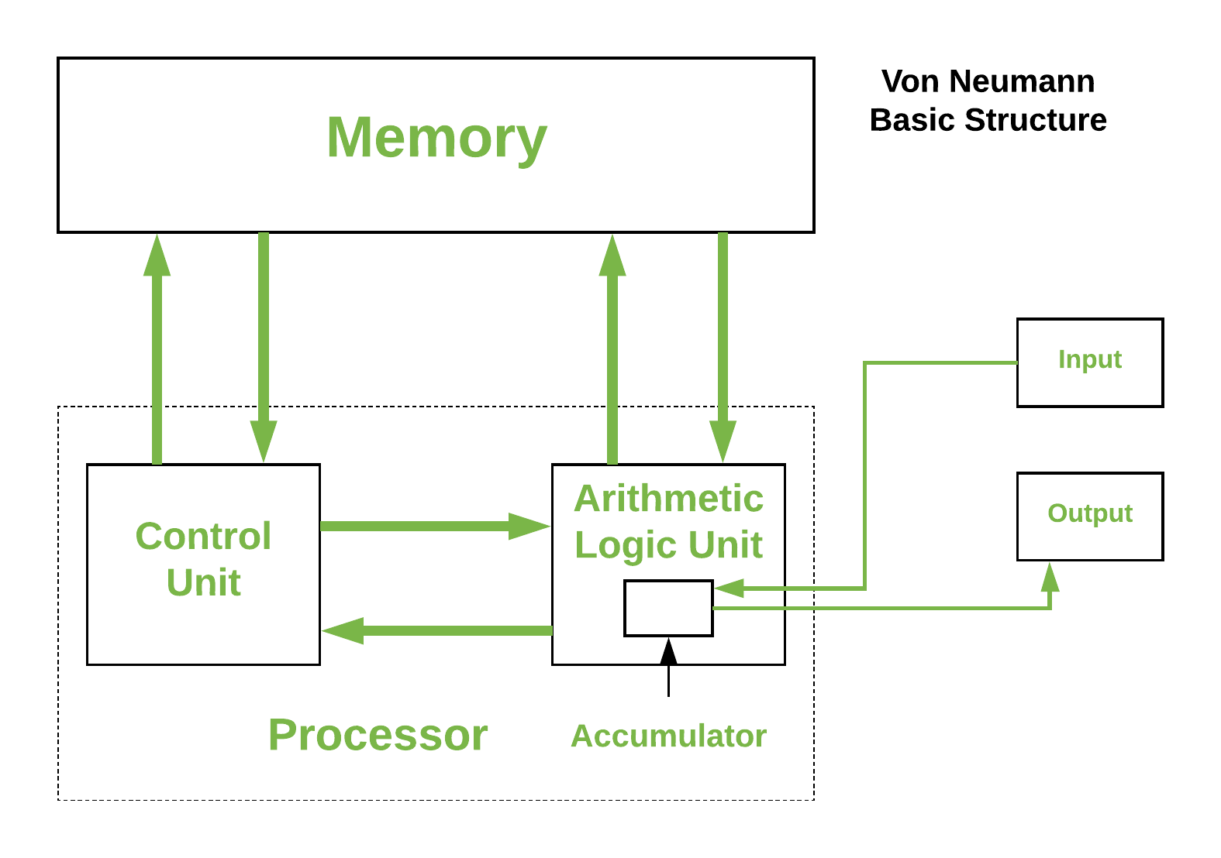
Conventional computer
Consists of a processor executing a program stored in a (main) memory.
Each main memory location located by its address. Addresses start at 0 and extend to 2^{n} -1 when there are n bits (binary digits) in the address. (You learned this in COA)
Image link: https://media.geeksforgeeks.org/wp-content/uploads/basic_structure.png

Slide 27
Multi-processor computer architecture
1. Flynn’s Classification
2. Shared memory model
3. Distributed memory model
4. Distributed shared memory model

Slide 28
Taxonomy (Classification)
A taxonomy of parallel architectures can be built based on three
relationships:
Relationship between PE and the instruction sequence executed
Relationship between PE and the memory
Relationship between PE and the interconnection network
PE: Processing Element (CPU)

Slide 29
Parallel Architecture
PE & Instruction
Sequence
PE & Memory
PE & Interconnection
Network
Micheal Flynn
SISD
SIMD
MISD
MIMD

Slide 30
Flynn taxonomy
Michael Flynn (1966) developed a taxonomy of parallel systems
based on the number of independent instruction and data streams.
SISD: Single Instruction Stream- Single Data Stream
This is a good conventional sequential Von Neumann machine.
2. MISD: Multiple Instruction Stream- Single Data Stream
SIMD: Single Instruction Stream- Multiple Data Stream
MIMD: Multiple Instruction Stream- Multiple Data Stream

Slide 31
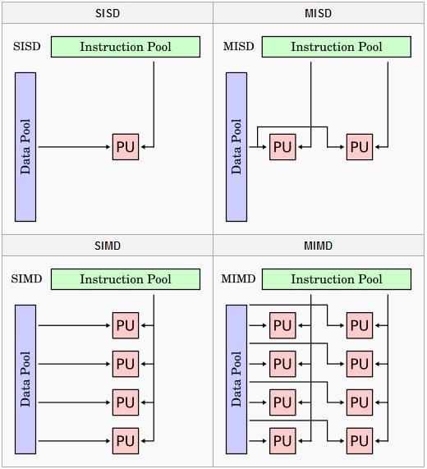
Flynn’s Classification

Slide 32
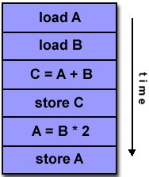
Flynn’s Classification
Single Instruction, Single Data (SISD):
A serial (non-parallel) computer
Single instruction: only one instruction stream is being acted on by the CPU during any one clock cycle
Single data: only one data stream is being used as input during any one clock cycle
Deterministic execution
This is the oldest and until recently, the most prevalent form of computer
Examples: most PCs, single CPU workstations and mainframes

Slide 33
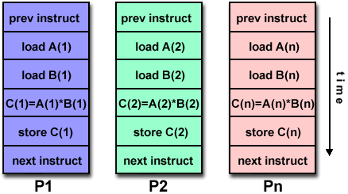
Flynn’s Classification
Single Instruction, Multiple Data (SIMD):
A type of parallel computer
Single instruction: All processing units execute the same instruction at any given clock cycle
Multiple data: Each processing unit can operate on a different data element
This type of machine typically has an instruction dispatcher, a very high-bandwidth internal network, and a very large array of very small-capacity instruction units.
Best suited for specialized problems characterized by a high degree of regularity,such as image processing.
Synchronous (lockstep) and deterministic execution
Two varieties: Processor Arrays and Vector Pipelines
Examples:
Processor Arrays: Connection Machine CM-2, Maspar MP-1, MP-2
Vector Pipelines: IBM 9000, Cray C90, Fujitsu VP, NEC SX-2, Hitachi S820

Slide 34
Flynn’s Classification
Multiple Instruction, Single Data (MISD):
A single data stream is fed into multiple processing units.
Each processing unit operates on data independently via independent instruction streams.
Few actual examples of this class of parallel
computer have ever existed. One is the
experimental Carnegie-Mellon computer
Some conceivable uses might be:
multiple frequency filters operating on a single signal stream
multiple cryptography algorithms attempting to crack a single coded message.

Slide 35
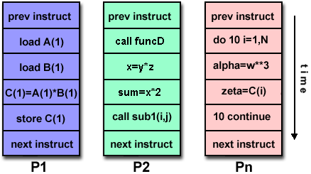
Flynn’s Classification
Multiple Instruction, Multiple Data (MIMD):
Currently, the most common type of parallel computer. Most modern computers fall into this category.
Multiple Instruction: every processor may be executing a different instruction stream
Multiple Data: every processor may be working with a different data stream
Execution can be synchronous or asynchronous, deterministic or non-deterministic
Examples: most current supercomputers, networked parallel computer "grids" and multi-processor SMP computers - including some types of PCs.

Slide 36
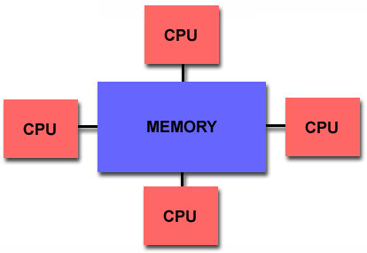
Parallel Computer Memory Architectures
Broadly divided into three categories
Shared memory
Distributed memory
Hybrid
Shared Memory
Shared memory parallel computers vary widely, but generally have in common the ability for all processors to access all memory as global address space.
Multiple processors can operate independently but share the same memory resources.
Changes in a memory location effected by one processor are visible to all other processors.
Shared memory machines can be divided into two main classes based upon memory access times: UMA and NUMA.

Slide 37
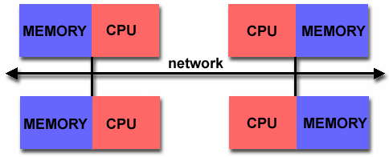
Parallel Computer Memory Architectures
Distributed Memory
Distributed memory systems require a communication network to connect inter-processor memory.
Processors have their own local memory. There is no concept of global address space across all processors.
Because each processor has its own local memory, it operates independently. Changes it makes to its local memory have no effect on the memory of other processors. Hence, the concept of cache coherency does not apply.
When a processor needs access to data in another processor, it is usually the task of the programmer to explicitly define how and when data is communicated. Synchronization between tasks is likewise the programmer's responsibility.
The network "fabric" used for data transfer varies widely, though it can be as simple as Ethernet.

Slide 38
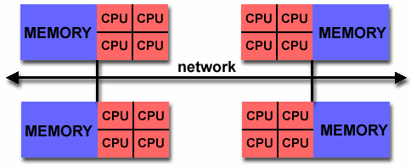
Parallel Computer Memory Architectures
Hybrid
The largest and fastest computers in the world today employ both shared and distributed memory architectures.
The shared memory component is usually a cache coherent SMP machine. Processors on a given SMP can address that machine's memory as global.
The distributed memory component is the networking of multiple SMPs. SMPs know only about their own memory - not the memory on another SMP. Therefore, network communications are required to move data from one SMP to another.
Current trends seem to indicate that this type of memory architecture will continue to prevail and increase at the high end of computing for the foreseeable future.
Advantages and Disadvantages: whatever is common to both shared and distributed memory architectures.

Slide 39
Parallel Programming Models
Overview
There are several parallel programming models in common use:
Shared Memory
Threads
Message Passing
Data Parallel
Hybrid
Parallel programming models exist as an abstraction above hardware and memory architectures.
Although it might not seem apparent, these models are NOT specific to a particular type of machine or memory architecture. In fact, any of these models can (theoretically) be implemented on any underlying hardware.

Slide 40
Single Program Multiple Data (SPMD) structure
Another programming structure we may use is the Single Program Multiple Data (SPMD) structure.
In this structure, a single source program is written and each processor will execute its personal copy of this program, although independently, and not in synchrony.
This source program can be constructed so that parts of the program are executed by certain computers and not others depending on the identity of the computer.
For a master-slave structure, the programs could have parts for the master and parts for slaves.

Slide 41
Multiple Program Multiple Data (MPMD) structure
Within the MIMD classification, each processor will have its own program to execute. This could be described as MPMD.
In this case, some of the programs to be executed could be copies of the same program.
Typically only two source programs are written, one for the designated master processor, and one for the remaining processors, which are called slave processors.

Slide 42
Three ways to create executable code for a shared memory multiprocessor
Parallel Programming Languages
With special parallel programming constructs and statements that allow shared variables and parallel code sections to be declared.
Then the compiler is responsible for producing the final executable code.
Threads
Contain regular high-level language code sequences for individual processors. These code sequences can then access shared locations.
Sequential programming
Use a regular sequential programming language and modify the syntax to specify parallelism.

Slide 43
Programming message-passing multicomputer
Dividing the problem into parts that are intended to be executed simultaneously to solve the problem
Common approach is to use message-passing library routines that are inserted into a conventional sequential program for message passing.
A problem is divided into a number of concurrent processes that may be executed on a different computer.
Processes communicate by sending messages; this will be the only way to distribute data and results between processes.

Slide 44
3. Distributed computing
44

Slide 45
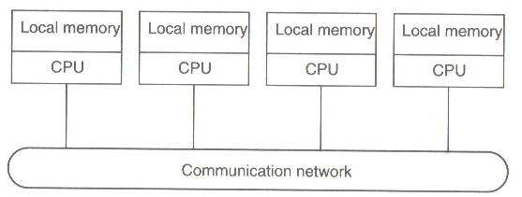
DS Introduction
Loosely coupled systems
Processors do not share memory
Each processor has its own local memory

Slide 46
Definition of Distributed Systems
“A distributed system is a collection of independent computers that appears to its users as a single coherent system.”
The definition has several important aspects
Autonomous components
Users (whether people or program) think they are dealing with a single system
A distributed system is a system in which components located at networked computers communicate and coordinate their actions only by passing messages.

Slide 47
Evolution of Distribution System
Two advances as the reason for spread of distributed systems
1. Powerful micro-processor:
• 8-bit, 16-bit, 32-bit, 64-bit
• x86 family, 68k family, CRAY, SPARC, dual core, multi-core
• Clock rate: up to 4Ghz
2. Computer network:
Local Area Network (LAN), Wide Area Network (WAN), MAN, Wireless Network type: Ethernet, Token-bus, Token-ring, Fiber Distributed Data Interface (FDDI), Asynchronous Transfer Mode (ATM), Fast-Ethernet, Gigabit Ethernet, Fiber Channel, Wavelength-Division Multiplex (WDM)
Transfer rate: 64 kbps up to 1Tbps

Slide 48
Distributed computing system models
Various models are used for building distributed computing systems.
These models can be broadly classified into five categories-
Minicomputer model
Workstation model
Workstation-server model
Processor-pool model
Hybrid model

Slide 49
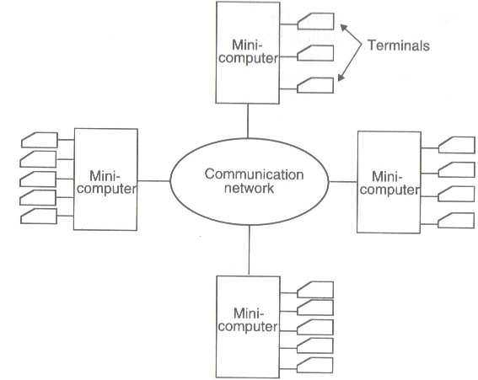
Distributed computing system models
1. Minicomputer model:
simple extension of centralized time-sharing systems
few minicomputers interconnected by communication network
each minicomputer has multiple users simultaneously logged on to it
this model may be used when when resource sharing with remote users is desired
Example: the early ARPAnet

Slide 50
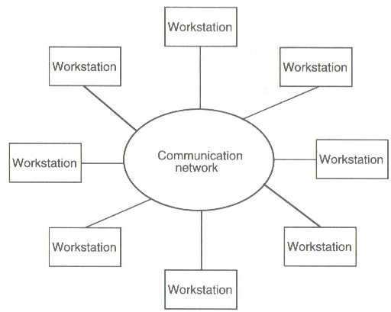
Distributed computing system models
2. Workstation model:
several workstations interconnected by communication network
basic idea is to share processor power
user logs onto home workstation and submits jobs for execution, system might transfer one or more processed to other workstations
issues must be resolved –
how to find an idle workstation
how to transfer
what happens to a remote process
Examples- Sprite system, Xerox PARC

Slide 51
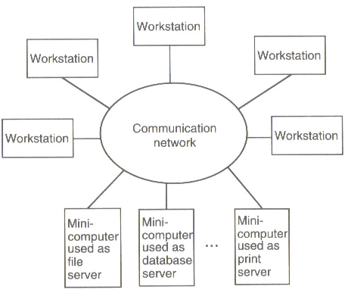
Distributed computing system models
3. Workstation-server model
It consists of a few minicomputers and several workstations (diskless or diskful)
Minicomputers are used for providing services
For higher reliability and better scalability multiple servers may be used for a purpose.
Compare this model with workstation model .
Example- The V-System

Slide 52
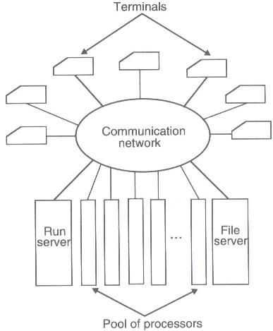
Distributed computing system models
4. Processor-pool model
Base observation –
sometimes user need NO computing power, but once in a while he needs very large amount of computing power for a short period of time
Run server manages and allocates the processors to different users
No concept of a home machine, i.e., a user does not log onto a particular machine but to the system as a whole.
Offers better utilization of processing power compared to other models.
Example: Amoeba, Plan9, Cambridge DCS.

Slide 53
Distributed computing system models
5. Hybrid Model
To combine the advantages of both workstation-server model and processor-pool model a hybrid model may be used
It is based on the workstation-server model but with addition of a pool of processors
Expensive!!

Slide 54
Distribution Model
There are several distribution models for accessing distributed resources and executing distributed applications as follows.
File Model - Resources are modeled as files. Remote resources are accessible simply by accessing files.
Remote Procedure Call Model - Resource accesses are modeled as function calls. Remote resources can be accessed by calling functions.
Distributed Object Model - Resources are modeled as objects which are a set of data and functions to be performed on the data. Remote resources are accessible simply by accessing an object.

Slide 55
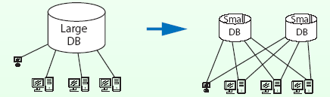
Advantages of Distributed Systems
Economics: Microprocessors offer a better price / performance than mainframes.
Speed: A distributed system may have more total computing power than a mainframe. E.g. one large database may be split into many small databases. In that way, we may improve response time.
Inherent distribution: Some application like banking, inventory systems involve spatially separated machines.

Slide 56
Advantages of Distributed Systems
Reliability: If 5% of the machines are downed, the system as a whole can still survive with a 5% degradation of performance.
Incremental growth: Computing power can be added in small increments
Sharing: Allow many users access to a common database and peripherals.
Communication: Make human-to-human communication easier.
Effective Resource Utilization: Spread the workload over the available machines in the most cost effective way.

Slide 57
Disadvantages of Distributed Systems
Software: It is harder to develop distributed software than centralized one.
Networking: The network can saturate or cause other problems.
Security: Easy access also applies to secret data.

Slide 58
Challenges in Distributed Systems
Heterogeneity - Within a distributed system, we have variety in networks, computer hardware, operating systems, programming languages, etc.
Openness - New services are added to distributed systems. To do that, specifications of components, or at least the interfaces to the components, must be published.
Transparency - One distributed system looks like a single computer by concealing distribution.
Performance - One of the objectives of distributed systems is achieving high performance out of cheap computers.

Slide 59
Challenges in Distributed Systems
Scalability - A distributed system may include thousands of computers. Whether the system works is the question in that large scale.
Failure Handling - One distributed system is composed of many components. That results in high probability of having failure in the system.
Security - Because many stake-holders are involved in a distributed system, the interaction must be authenticated, the data must be concealed from unauthorized users, and so on.
Concurrency - Many programs run simultaneously in a system and they share resources. They should not interfere with each other

Slide 60
Heterogeneity
A distributed system is composed of a heterogeneous collection of computers
Heterogeneity arises in the following areas-
networks: Even if the same Internet protocol is used to communicate, the performance parameters may widely vary within the inter-network.
computer hardware: Internal representation of data is different for different processors.
operating systems: The interface for exchanging messages is different from one operating system to another.
programming languages: Characters and data structures are represented differently by different programming languages.
implementations by different developers: Unless common standards are observed, different implementations cannot communicate.

Slide 61
Openness
Openness means disclosing information: the usage of services provided by remote computers.
Open systems are easier to extend and reuse.
By making services open, servers can be used by various clients.
The clients which use services provided by other servers can extend the services and again provide services to other clients.
The openness of distributed systems let us add new services and increase availability of services to different clients.

Slide 62
Transparency
Transparency means hiding something.
Transparency is an important issue to realize the single system image which makes systems as easy to use as a single processor system. E.g. WWW we can access whatever information by clicking links without knowing whereabouts of the host.
Classification of Transparency
Access transparency: Data and resources can be used in a consistent way.
Location transparency: A user cannot tell where resources are located
Migration transparency: Resources can move at will without changing their names.

Slide 63
Classification of Transparency
Replication transparency: A user cannot tell how many copies exist.
Concurrency transparency: Multiple users can share resources automatically.
Failure transparency: A user does not notice resource failure.
Performance transparency: Systems are reconfigured to improve performance as loads vary
Scaling transparency: Systems can expand in size without changing the system structure and the application programs.

Slide 64
Performance
Fine-grained parallelism: Small programs are executed in parallel.
Large number of messages.
Communication overhead decreases the performance gain with parallel processing.
Coarse-grained parallelism:
Long compute-bound programs executed in parallel.
Communication overhead is less in this case.

Slide 65
Scalability
Scalability is the issue whether a distributed system works and the performance increases when more computers are added to the system.
The followings are potential bottle-necks in very large distributed systems
Centralized components: A single mail server for all users.
Centralized tables: A single on-line telephone book
Centralized algorithms: Routing based on complete information
Use decentralized algorithms for scalability:
No machine has complete information about the system state.
Machines make decisions based only on local information.
Failure of one machine does not completely invalidate the algorithm.

Slide 66
Reliability
We have high probability to have faulty components in a distributed system because the system includes large number of components.
On the other hand, it is theoretically possible to build a distributed system such that if a machine goes down, the other machine takes over the job.
Reliability has several aspects.
Availability: The fraction of time that the system is available. It can be expressed by the following equation-
Fault tolerance: Distributed systems can hide failures from the users.

Slide 67
Performance
Maximum aggregate performance of the system can be measured in terms of Maximum aggregate floating-point operations.
P = N*C*F*R
Where P performance in flops, N number of nodes, C number of CPUs, F floating point ops per clock period - FLOP, R clock rate.
The similar measures with MOP/MIP.

Slide 68
Scalability
It is computed as
S = T(1) / T(N)
Where T(1) is the wall clock time for a program to run on a single processor.
T(N) is the runtime over N processors.
A scalability figure close to N means the program scales well.
Scalability metric helps estimate the optimal number of processors for an application.

Slide 69
Utilization
It is calculated as,
U = S(N)/N
Values close to unity or 100% are ideally sought.

Slide 70
Summation
What is a Distributed System?
“A distributed system is a collection of independent computers that appears to its users as a single coherent system.”
Models of Distributed System?
Minicomputer model
Workstation model
Workstation-server model
Processor-pool model
Hybrid model
What are the Strengths and Weaknesses of a Distributed System?
S: Reliability, Incremental growth, Resource sharing
W: Programming, Reliance on network, Security
Important characteristics of of a Distributed System?
Heterogeneity, Openness, Transparency
Performance Metrics?

Slide 71
4. Parallel computing performance
71

Slide 72
Potential for increased computational speed
Process
In all forms of MIMD multiprocessor/multicomputer systems, it is necessary to divide the computations into tasks or processes that can be executed simultaneously.
The size of a process can be described by its granularity, which is related to the number of processors being used.
In coarse granularity, each process contains a large number of sequential instructions and takes substantial time to execute.
72

Slide 73
In fine granularity, a process might consists of few instructions or perhaps even one instruction.
Medium granularity describes the middle ground.
Sometimes granularity is defined as the size of the computation between communication or synchronization points.
Generally we want to increase the granularity to reduce the cost of process creation and inter-process communication, but of course this will likely reduce the number of concurrent processes and amount of parallelism. A suitable compromise has to be made.
73

Slide 74
The ratio
can be used as a granularity metric.
74

Slide 75
Speed-Up factor
A measure of relative performance between a multiprocessor system and a single processor system in the speed- up factor, S(n), defined as
75

Slide 76
The factor S_{(n)} gives the increase in speed due to using a multiprocessor
For comparing a parallel solution with a sequential solution, we will use the fastest known sequential algorithm for running on a single processor. The underlying algorithm for a parallel implementation might be (and is usually) different.
The speed up factor can also be cast in terms of computational steps:
The maximum speedup is n with n processors (linear speed up).
76

Slide 77
Superlinear Speedup
where S(n) > n, may be seen on occasion, but usually this is due to using a suboptimal sequential algorithm or some unique feature of the architecture that favors the parallel formation.
One common reason for superlinear speedup is the extra memory in the multiprocessor system which can hold more of the problem data at any instant, it leads to less relatively slow disk-memory traffic.
Superlinear speedup can occur in search algorithms.
77

Slide 78
Space-time diagram of a message passing program
It is reasonable to expect that some part of a computation cannot be divided at all into concurrent processes and must be performed serially.
During the initialization period or period before concurrent processes are being setup, only one processor is doing useful work, but for the rest of the computation, additional processors are operating in parallel.
The figure on the next page illustrates a space-time diagram of a message-passing program that has one process on each of four processors. It starts with one process and later others begin to execute and send messages back. In general we would expect periods when processors are idle and are waiting to send their messages.
78

Slide 79
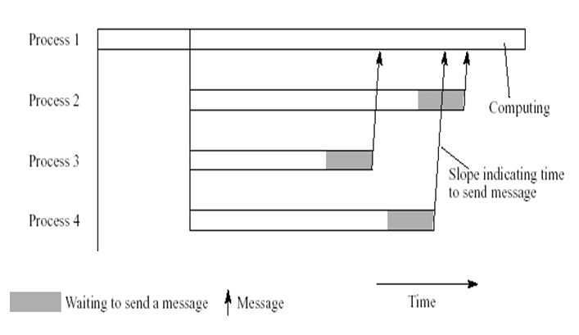
Space- time diagram of a message- passing program
79

Slide 80
Maximum speed
If the fraction of the computation that cannot be divided into concurrent tasks is f, the time to perform the computation with p processors is given by ft_{s} + (1-f) t_{s}/p as shown in the next slide.
Illustrated is the case with a single serial part at the beginning of the computation which cannot be parallelized, but the remaining parts could be distributed throughout the computation.
The speed up factor S(p) is given by
Fraction of the computation that cannot be parallelized
Fraction of the computation that can be parallelized
Number of processors
Speed up factor
The total sequential time
This whole thing is t_{p}
80
Notes:
80

Slide 81
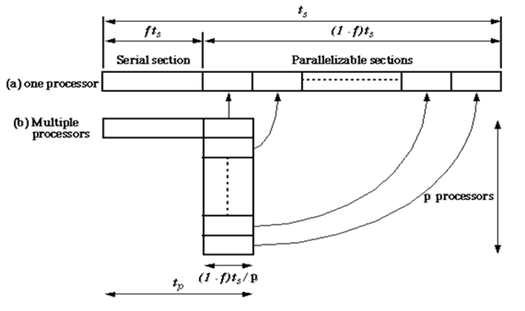
Parallelizing sequential problem-Amdahl’s law
Alternative:
is the serial ratio (non-parallelizable portion)
is the number
of processors
81
is the parallel ratio (parallelizable portion)

Slide 82
This equation is known as Amdahl’s law.
It shows S(n) plotted against number of processors and against f. If a significant increase in speed of computation is to be achieved, the fraction of computation that is executed by concurrent processes needs to be substantial fraction of the overall computation.
Even with infinite number of processors, maximum speedup limited to 1/f.
i.e., S(n) =1/f
n→ ∞
82

Slide 83
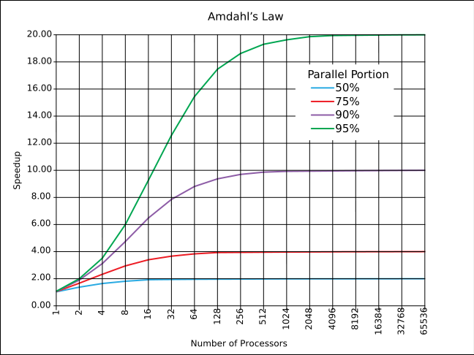
Amdahl's law
Notes:
Ref Wikipedia Amdahl's law

Slide 84
Efficiency
Efficiency
0 ≤ ε(n,p) ≤ 1
Amdahl’s law
Let f = σ(n)/(σ(n) + ϕ(n)); i.e., f is the fraction of the code which is inherently sequential
Efficiency
Speedup
=
Processors
Notes:
Hint: Divide and multiply Amdahl’s speed-up expression with (σ(n) + ϕ(n)) to reduce the numerator to unity.
Then replace the parallelisable code fraction = ϕ(n)/(σ(n) + ϕ(n)) with (1 – f) to obtain the simplified expression at the bottom of the slide.

Slide 85
Examples
95% of a program’s execution time occurs inside a loop that can be executed in parallel. What is the maximum speedup we should expect from a parallel version of the program executing on 8 CPUs?
20% of a program’s execution time is spent within inherently sequential code. What is the limit to the speedup achievable by a parallel version of the program?
Notes:
For the max possible speedup, P (no of processors) must approach infinity.

Slide 86
Amdahl's law
Limitations of Amdahl’s Law
Ignores κ(n,p) - overestimates speedup
Assumes f constant, so underestimates speedup achievable
Amdahl Effect
Typically κ(n,p) has lower complexity than ϕ(n)/p
As n increases, ϕ(n)/p dominates κ(n,p)
As n increases, speedup increases
As n increases, sequential fraction f decreases.
Speedup
n = 10,000
n = 1,000
n = 100
Processors

Slide 87
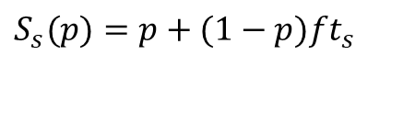
Gustafson’s law
Gustafson's Law (also known as Gustafson-Barsis' law, 1988) states that any sufficiently large problem can be efficiently parallelized.
Gustafson's Law is closely related to Amdahl's law, which gives a limit to the degree to which a program can be sped up due to parallelization.
where p is the number of processors, s is the speedup, and f the non-parallelizable part of the process
Gustafson's law addresses the shortcomings of Amdahl's law, which cannot scale to match availability of computing power as the machine size increases.
$$S_{s}(p)=p+(1−p)ft_{s}$$

Slide 88
Scaled speedup Factor
If we fix the parallel execution time t_{p} and the fraction of the process which cannot be parallelized f, we can use Gustafson’s law to figure out the speed-up factor given the number of processors, p.
This is called the scaled speedup factor because the t_{p} is scaled to 1.
Scaled speedup
The whole numerator is the t_{s} (sequential time)
The whole denominator is the t_{p} (parallel time)
Because the t_{p} is scaled, this becomes 1
How the numerator becomes this will be explained on the following slide.
88

Slide 89
Scaled speedup Factor (cont.)
The denominator tp which we scaled to 1 was
ft_{s} + (1-f)t_{s}/p = 1
pft_{s}+(1-f)t_{s} = p
t_{s} = p + (1-p) ft_{s}
Hence, we get
89

Slide 90
5. Parallel vs. distributed vs. asynchronous computing
90

Slide 91
Parallel vs. Distributed computing
S.NO | PARALLEL COMPUTING | DISTRIBUTED COMPUTING
1. | Many operations are performed simultaneously | System components are located at different locations
2. | Single computer is required | Uses multiple computers
3. | Multiple processors perform multiple operations | Multiple computers perform multiple operations
4. | It may have shared or distributed memory | It have only distributed memory
5. | Processors communicate with each other through bus | Computer communicate with each other through message passing.
6. | Improves the system performance | Improves system scalability, fault tolerance and resource sharing capabilities
Source: https://www.geeksforgeeks.org/difference-between-parallel-computing-and-distributed-computing/

Slide 92
Parallel vs. Asynchronous computing
Both parallel and asynchronous programming models perform similar tasks and functions in modern programming languages.
However, these models have conceptual differences.
Asynchronous programming is used to avoid “blocking” within a software application. Example, database queries or network connections are best implemented using asynchronous programming.
An asynchronous call spins off a thread (e.g. an I/O thread) to complete the target task.
An asynchronous calls prevents the user interface from the “freeze” effect.

Slide 93
Parallel vs. Asynchronous computing
As for parallel programming, the main task is segmented into smaller tasks, to be executed by a set of threads within the reach of a common variable pool.
Parallel programming can also prevent user interface “freeze” effect when running computational expensive tasks on a CPU.
Key difference: In an asynchronous call, control over threads is limited and is system dependent. In parallel programming, the user has more control over task distribution, based on the number of available logical processors.
Source: http://www.peter-urda.com/2010/10/asynchronous-versus-parallel-programming

